Slide 1
AVL Tree

Slide 2
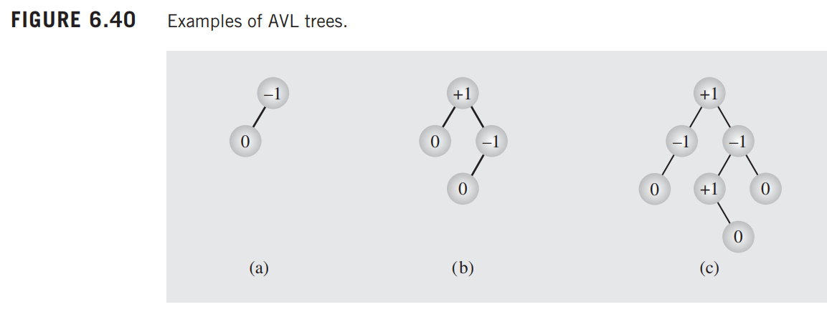
AVL Tree
AVL Tree is a self-balancing binary search tree.
Named after inventors Adelson-Velsky and Landis.
Maintains balance to ensure time complexity of O(log n).

Slide 3
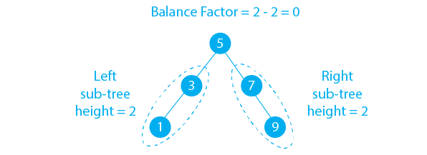
Balance Factor
Balance factor = Height of left subtree - Height of right subtree.
For AVL trees, balance factor must be -1, 0, or 1.
Formula:
Balance Factor = Height(Left Subtree) - Height(Right Subtree).

Slide 4
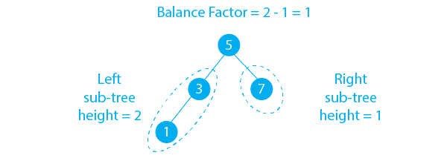
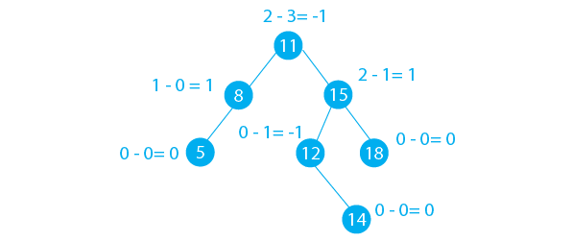
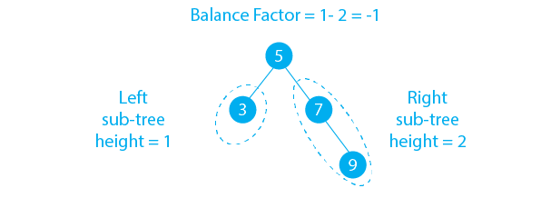

Slide 5
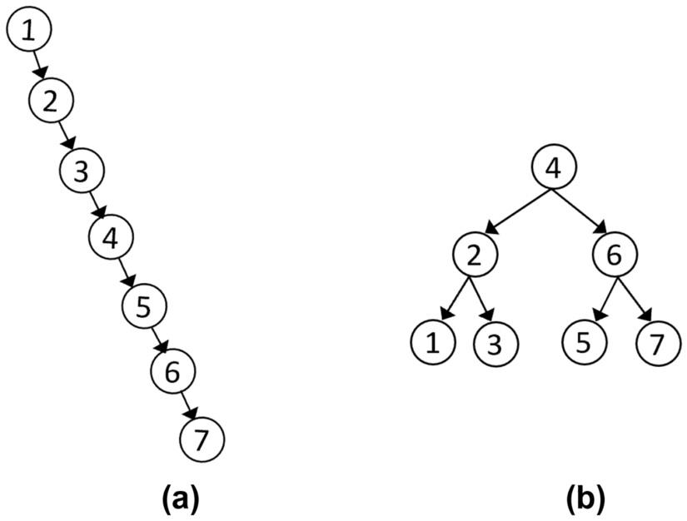
If the balance factor goes outside the range (-1, 0, 1), the tree becomes unbalanced.

Slide 6
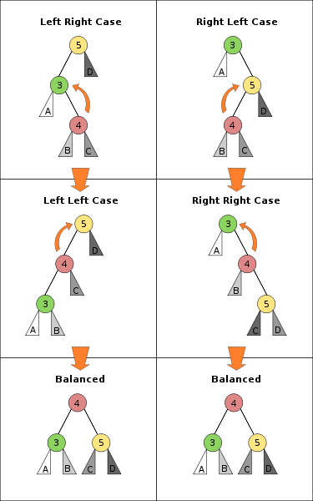
Rotations in AVL Trees
Rotations are used to restore balance.
Types:
Single Rotations:
Left Rotation,
Right Rotation.
Double Rotations:
Left-Right Rotation,
Right-Left Rotation.

Slide 7
Rotations in AVL tree:
There are four types of rotation in the AVL tree:
LL Rotation: this rotation is performed when a newly inserted node is in the left sub-tree of the left subtree of the particular node.
RR Rotation: this rotation is performed when a newly inserted node is in the right sub-tree of the right subtree of the particular node.
LR Rotation: this rotation is performed when a newly inserted node is in the right sub-tree of the left subtree of the particular node.
RL Rotation: this rotation is performed when a newly inserted node is in the left sub-tree of the right subtree of the particular node.

Slide 8
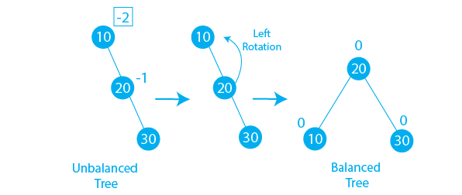
Left Rotation
We do left rotation when Right subtree is heavier than the left.
Or when the right subtree is taller than the left subtree.
Insert an element into a right-heavy tree and apply a left rotation.
The right child becomes the new root, and the original root becomes the left child of the new root.

Slide 9
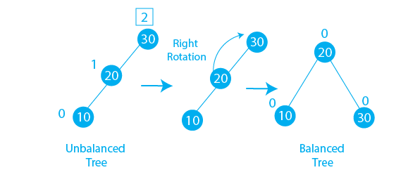
Right Rotation
We do right rotation when Left subtree is heavier than the right.
Or the left subtree is taller than the right subtree.
Insert an element into a left-heavy tree and apply a right rotation.
The left child becomes the new root, and the original root becomes the right child of the new root.

Slide 10
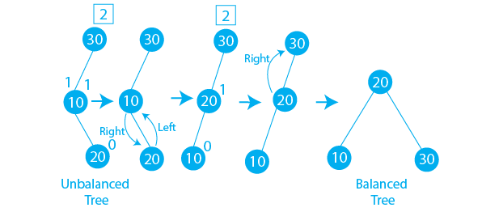
LR Rotation
In the above example, we have inserted a new node 20 to the right of the left to node 30. We can see that after inserting a new node the balance factor of node 30 becomes -2 and the tree becomes unbalanced. To make this tree balanced tree we will apply LR Rotation on the tree. We will apply the left rotation and after that, we will apply the right rotation. Now the tree becomes unbalanced like in the first case and we have to apply LL Rotation. We can see the resultant tree becomes balanced.

Slide 11
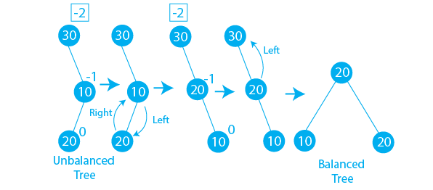
RL Rotation
In the above example, we have inserted a new node 20 to the left of the right to node 30. We can see that after inserting a new node the balance factor of node 30 becomes -2 and the tree becomes unbalanced. To make this tree balanced tree we will apply RL Rotation on the tree. We will apply the right rotation and after that, we will apply the left rotation. Now the tree becomes unbalanced like in the second case and we have to apply RR Rotation. We can see the resultant tree becomes balanced.

Slide 12
Insertion in AVL Trees
Same as BST insertion, but re-balance using rotations if needed.
Steps:
Insert the node as in a BST.
Update the balance factor of each node.
If balance factor goes out of range, perform rotation(s).

Slide 13
AVL tree in data structure example with dry-run
Insertion:
Let’s see how an insertion operation is performed in the AVL tree.
Elements = 17 18 19 11 10

Slide 14
Program of the AVL tree in data structure:
https://docs.google.com/document/d/13DNIRObmNpgR4aWOBu4LGDn1c8DIgV0QZsmD7obIJN8/edit?usp=sharing

Slide 15
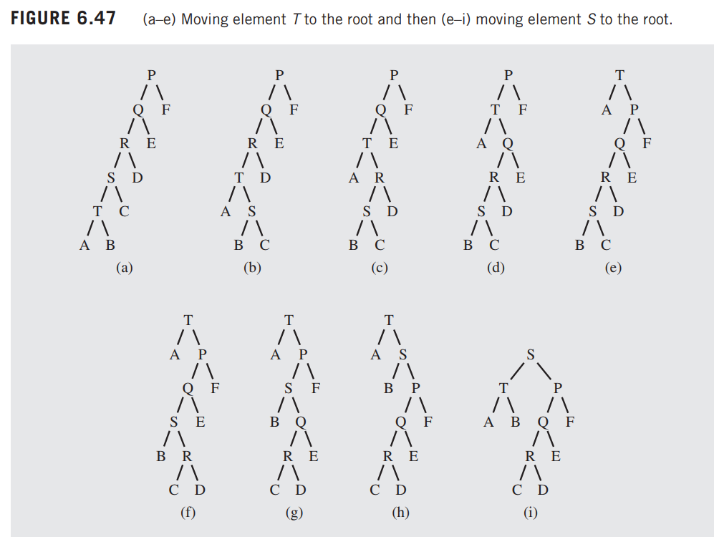

Slide 16
Deletion in AVL Trees
Same as BST deletion, but re-balance afterward.
Steps:
Delete the node as in a BST.
Update the balance factors.
If any node becomes unbalanced, perform rotations.

